Slide 1
THE COMMUNICATION PROCESS -CONT’D

Slide 2
Steps of the communication process
The communication process incorporates a two-way system in which a message (which can be an idea, thought, feeling, or opinion) is conveyed at least between two persons via a channel of communication.
Development of the idea to be sent The sender has to develop an idea to speak of to the intended person or group of people.
He/she thinks of the subject of the information or matter they want to talk about
Encoding of the message by the sender Once the idea is developed in the mind of the sender, it is followed by the encoding of the message.
Putting the message into a form that can be understood by the audience. If the person is planning for verbal communication, they will speak orally e.g If they are writing a letter, they will use written words to express their thoughts and ideas.

Slide 3
Steps cont’d
Selection of the channel that will be used for communication This is involves the selection of the channel that will be used for the transmission of the message eg electrical transmission, nonverbal, verbal, etc. If a person is communicating in a professional environment, they have to adopt a more professional & organized means of communication.
Message traversing the channel of communication Once the channel is set, the message is conveyed through the process of communication. The entire process banks on the chosen medium for communicating your message. For the proper and orderly delivery of the message, the appropriate medium must be chosen.

Slide 4
Steps cont’d
Receival of the message by the receiver Once the entire medium is traversed by the message, it is received by the receiver. This is a receptive process in communication, and the person can receive it through listening, reading, feeling, etc.
Decoding of the message by the receiver Once the receiver successfully receives the message, the decoding of the message begins: The interpretation of the message and its conversion into a thought followed by message analysis and understanding of the message received.
Note: This process becomes more effective when the same medium is used by the receiver and the sender for the transmission and receipt of the message.

Slide 5
Steps cont’d
Feedback(if desired). Once the interpretation is dealt with, feedback follows. However this is not compulsory and might not occur if the communication is one way. In the form of a reply, the recipient might give feedback to the sender. This helps the sender in making sure that the message sent was properly sent and interpreted by the receiver. This takes the shape of two-way communication between two people

Slide 6
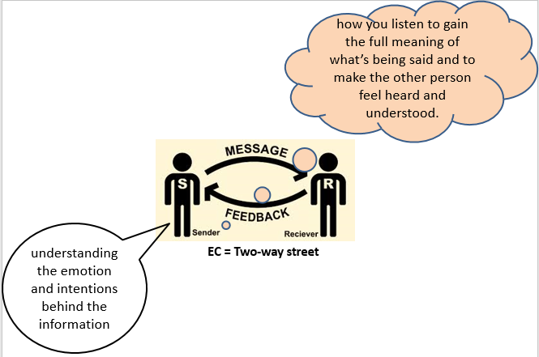
EFFECTIVE COMMUNICATION
Effective communication is the process of exchanging ideas, thoughts, opinions, knowledge, and data so that the message is received and understood with clarity and purpose.
Notes:
we can learn how to communicate more clearly and effectively. Each Individual can improve communication skills that enable them to effectively connect with others, build trust and respect, and feel heard and understood.

Slide 7
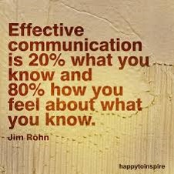
Effective communication cont’d
Is more than just the words you use, it combines a set of skills including nonverbal communication, engaged listening, managing stress in the moment, the ability to communicate assertively, and the capacity to recognize and understand your own emotions and those of the person you’re communicating with.

Slide 8
Importance of effective communication
1. Building trust
Effective communication fosters trust with others. Your ability to listen attentively and embrace different points of view helps others trust that you are making optimal decisions for everyone in the group. As you serve as a role model, this trust will extend to your team and they will feel as though they can trust their teammates to fulfill their duties and responsibilities.
2. Preventing or resolving problems
The ability to communicate effectively plays a large role in resolving conflicts and preventing potential ones from arising. The key is to remain calm, make sure all parties are heard and find a solution that is ideal for everyone involved.

Slide 9
Importance cont’d
3. Improves productivity
When team members understand their roles, the roles of others and your expectations, they can focus more on their work and less on workplace issues. With effective communication, conflicts are resolved quickly, employees can better manage their workload and distractions are minimized. These benefits contribute to greater productivity for you and your team.
4. Promotes team building
With improved communication, team members will be better able to rely on each other. You will not have one team member feel as though they have to carry the entire group. This improved division of labor will encourage positive feelings and relationships between the team members, which leads to improved morale and work experiences.

Slide 10
Importance cont’d
5. Creates better relationships
Good communication also improves relationships, both with employees and in your personal life with friends and family members. Listening carefully and offering quality feedback helps people to feel heard and understood. This, in turn, nurtures mutual respect.
6. Providing clarity and direction
With effective communication skills, you’re able to deliver clear expectations and objectives always anywhere. This involves finding constructive ways to point out when something isn’t working as well as providing helpful feedback to get people back on track. This in turn will help eliminate conflicts and confusion.

Slide 11
Barriers of effective communication
These communication barriers are categorized into the following:
Physical barriers eg background music, talking in the background etc
Language barriers
Psychological barriers eg stereotypes, biases, perceptions, assumptions, unwillingness to listen
Physiological barriers eg illness, fatigues, physical impairment like deafness, blindness, stress & out of control emotions
Systematic barriers eg poor network
Semantic noise eg caused by the sender e.g. grammar, pronunciations etc
Notes:
Despite the importance of communication, it faces many obstacles. These obstacles make the communication process uncomfortable and stressful.

Slide 12
How to overcome barriers of effective communication
Checking whether it is a good time and place to communicate with the person.
Being clear and using language that the person understands.
Communicating one thing at a time
Respecting a person’s desire to not communicate
Checking that the person has understood you correctly
Communicating in a location that is free of distractions
Acknowledging any emotional responses the person has to what you have said

Slide 13
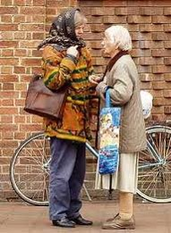
Improving communication skills
Become an engaged listener
Being attentive, understanding what is being said, Absorbing and interpreting non verbal messages, making an effort to understand, reflecting back and summarizing
Focus fully on the speaker
Avoid interrupting or trying to redirect
the conversation to your concerns
Show your interest in what’s being said
Try to set aside judgment
Provide feedback

Slide 14
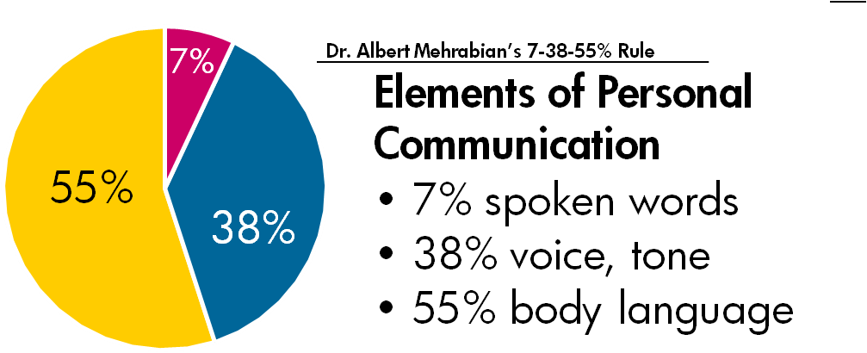
Pay attention to non-verbal signals
Eg facial expressions, body movement and gestures, eye contact, posture, the tone of your voice, and even your muscle tension and breathing

Slide 15
Keep stress in check, Stay calm under pressure
Use stalling tactics to give yourself time to think. Have a question repeated, or ask for clarification of a statement before responding.
Pause to collect your thoughts. Silence isn’t necessarily a bad thing—pausing can make you seem more in control than rushing your response.
Make one point and provide an example or supporting piece of information.
Deliver your words clearly
Wrap up with a summary and then stop. Summarize your response and then stop talking, even if it leaves a silence in the room.

Slide 16
Assert yourself
Direct, assertive expression makes for clear communication and can help boost self-esteem and decision-making.
Value yourself and your opinions. They are as important as anyone else’s.
Know your needs and wants. Learn to express them without infringing on the rights of others.
Express negative thoughts in a positive way. It’s OK to be angry, but you must be respectful as well.
Receive feedback positively. Accept compliments graciously, learn from your mistakes, ask for help when needed.
Learn to say “no.” Know your limits and don’t let others take advantage of you. Look for alternatives so everyone feels good about the outcome.

Slide 17

THANK YOU FOR LISTENING

